Slide 2
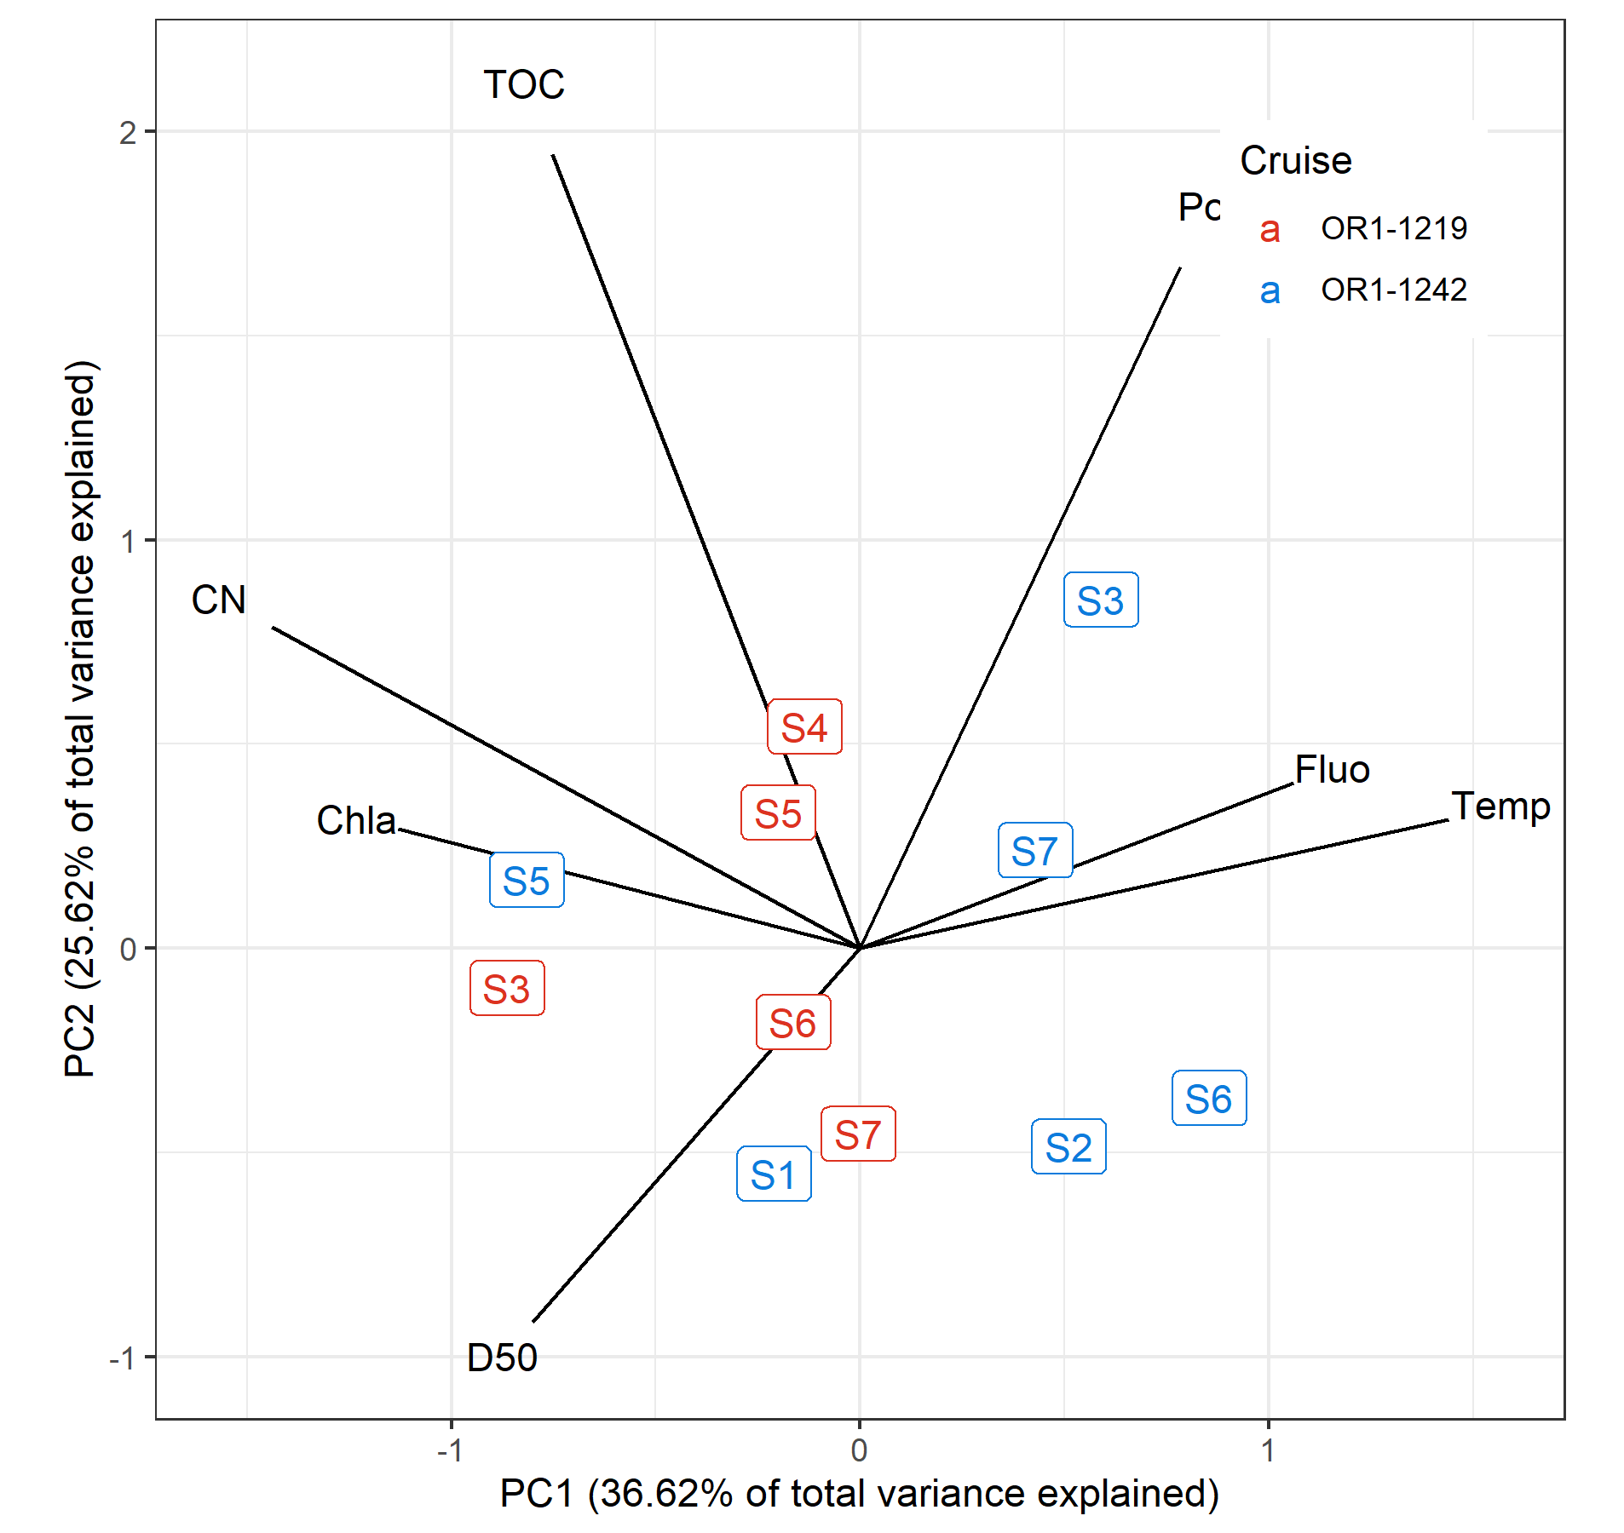
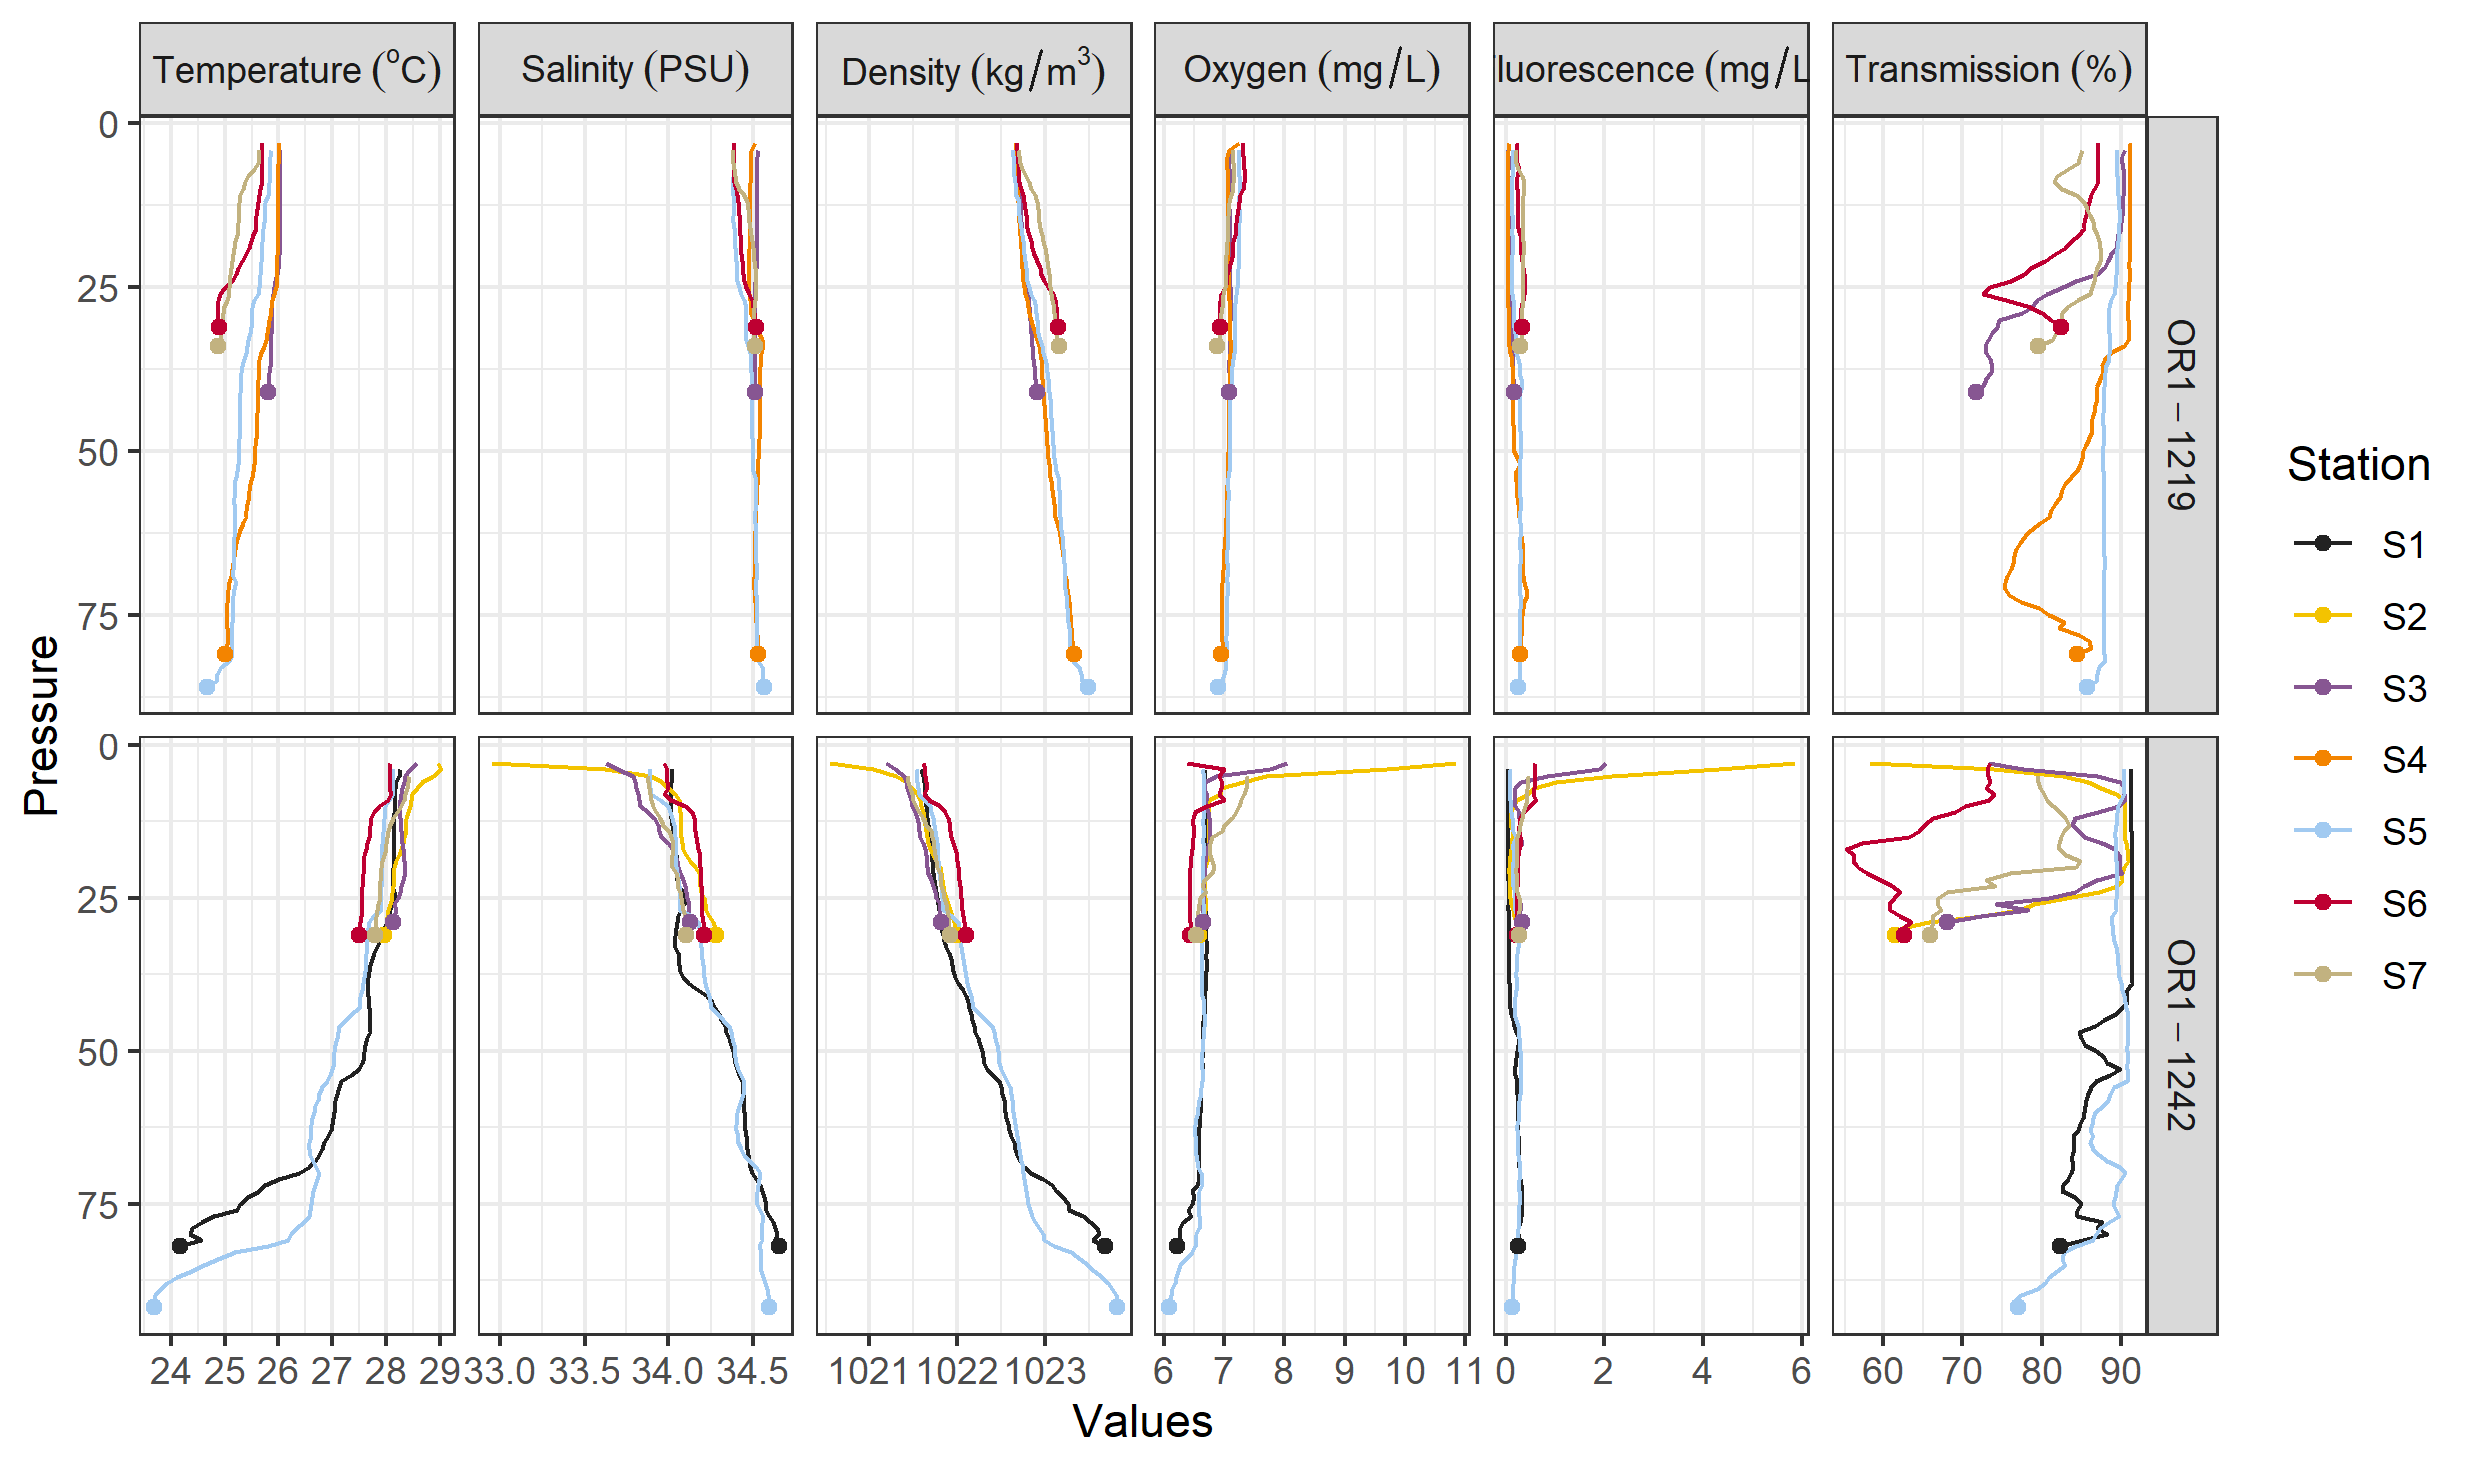
Environmental data
Depth and DRM were not included for this PCA and later analyses
Variables with |r| > 0.7 and/or ecologically irrelevant were omitted
Sal, Trans, Dens, Temp are highly correlated ➔ choosing Temp
Delta 13 C and Chla negatively correlated ➔ choosing Chla
TN correlated with Porosity ➔ choosing Por

Slide 3
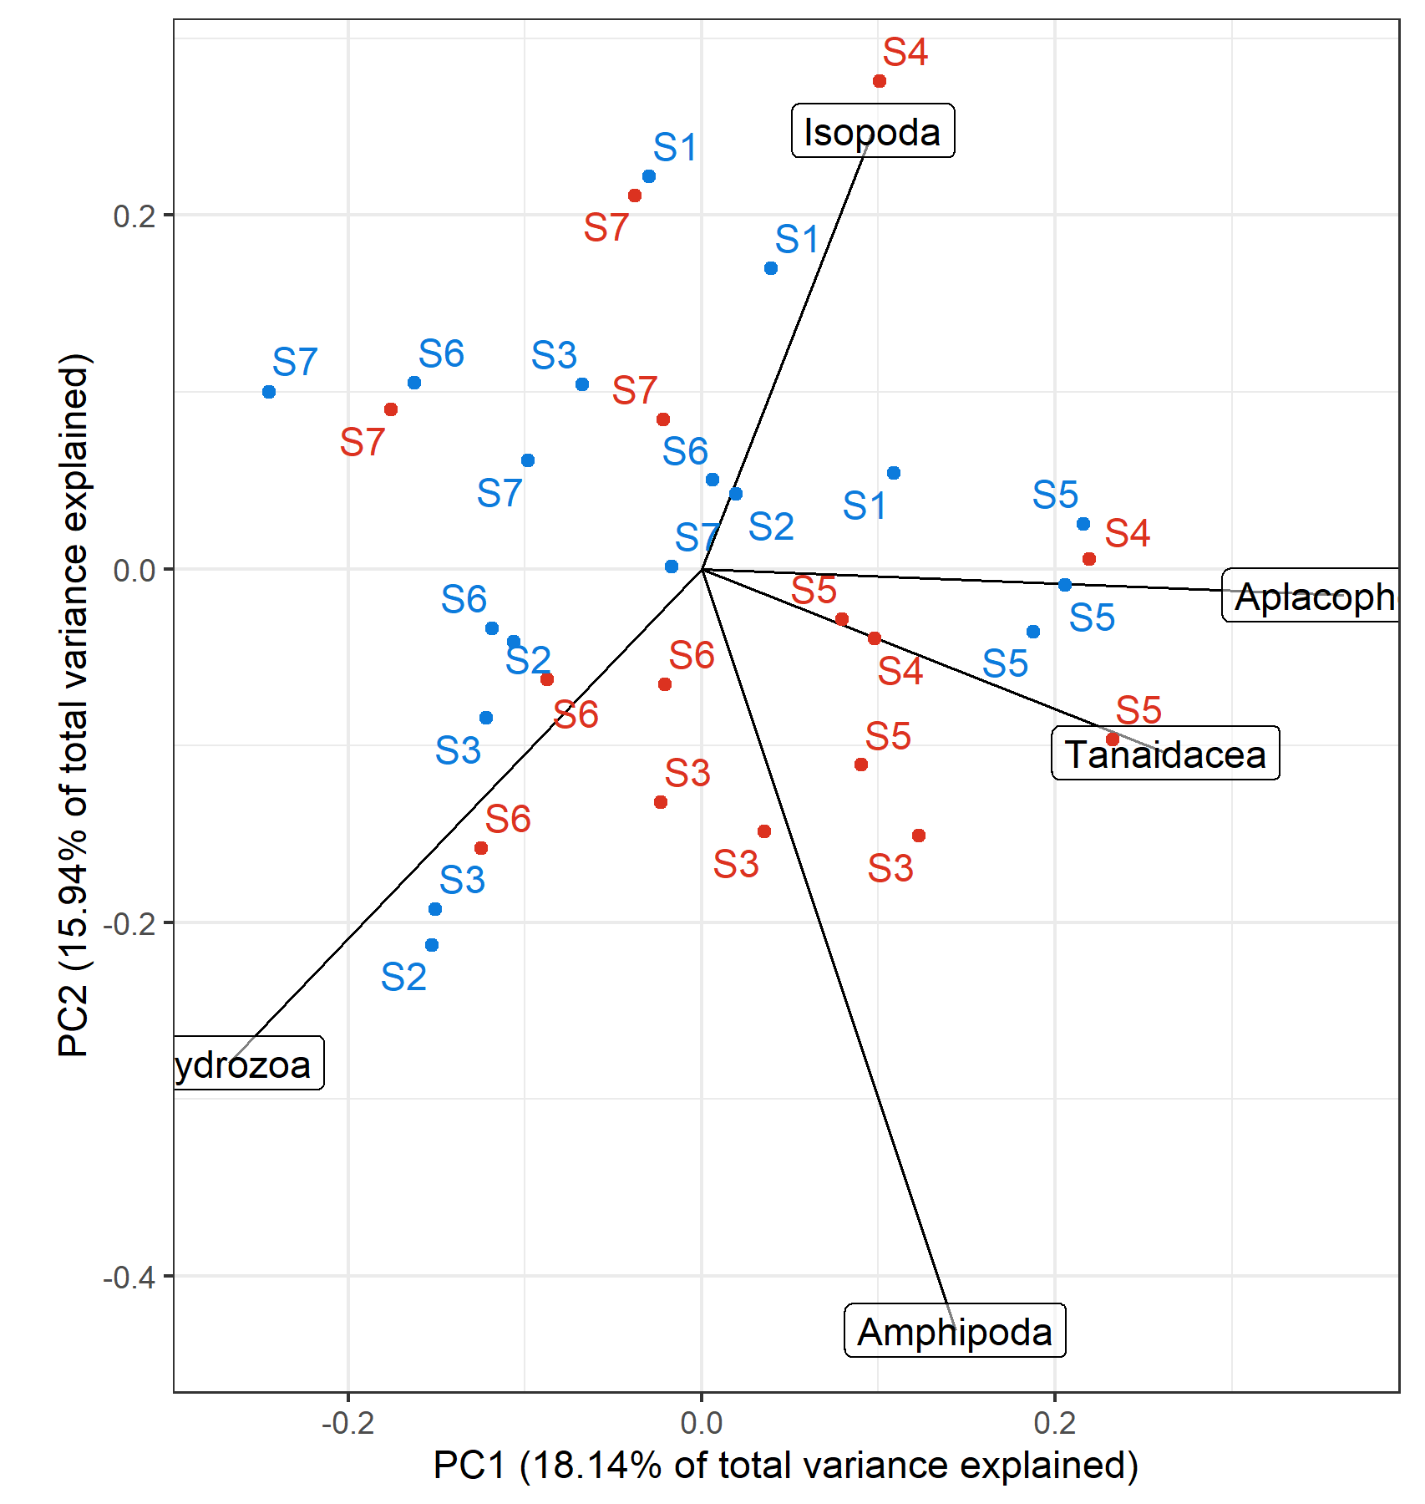
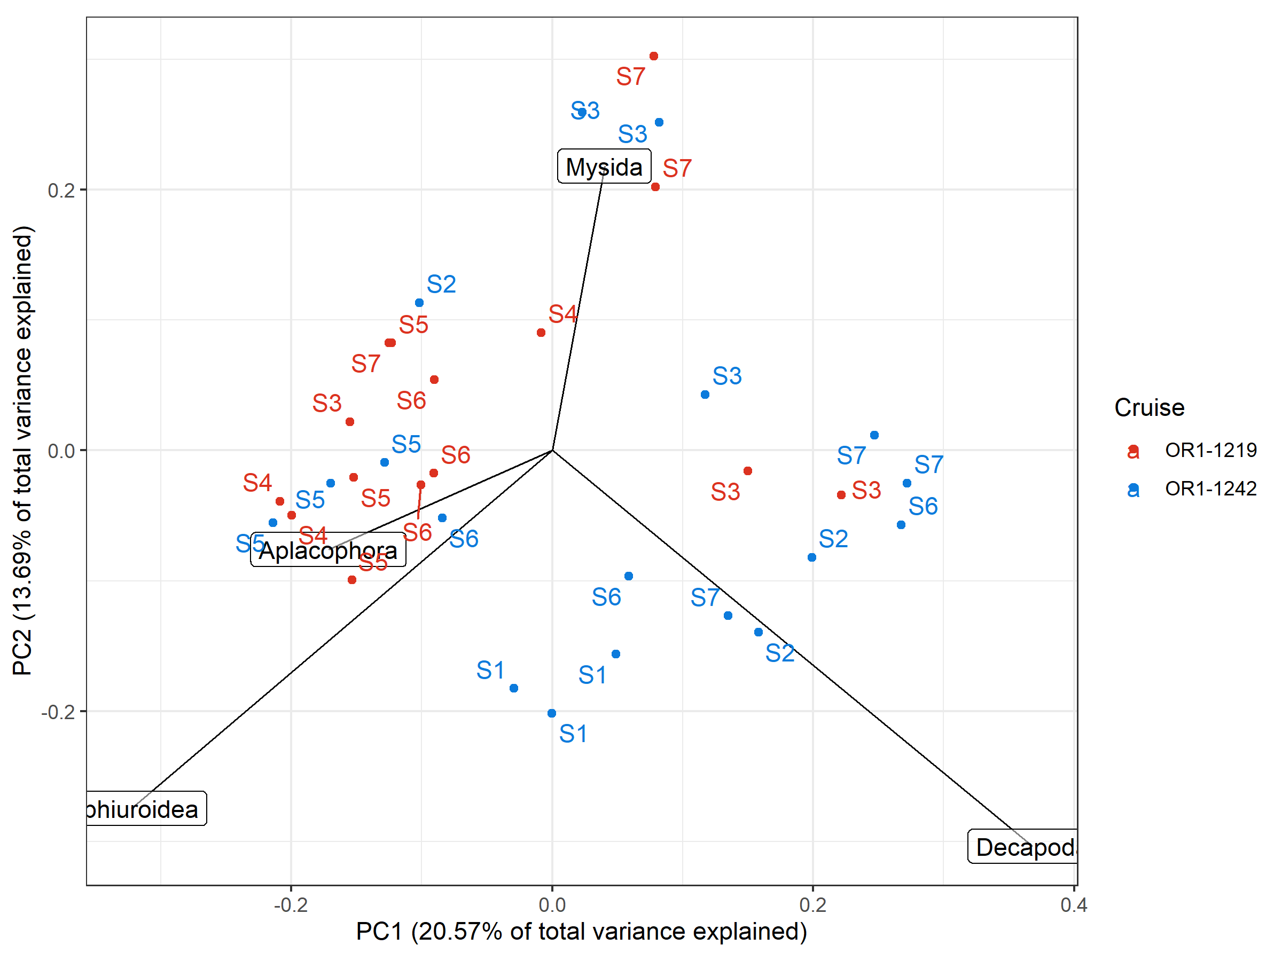
Box-Cox-chord transformed assemblage PCA, scaling 1 only taxa with >40% variance explained by the first two axes were shown
Count, exponent = 0.3
Biomass, exponent = 0.1
*Variation of peracarid abundance were largely captured within the first two PCs
*Biomass composition mainly reflects the presence of large taxa; noticeable groupings were present (if these are non-stochastic)
Notes:
Perhaps, the abundance of peracarids are

Slide 4
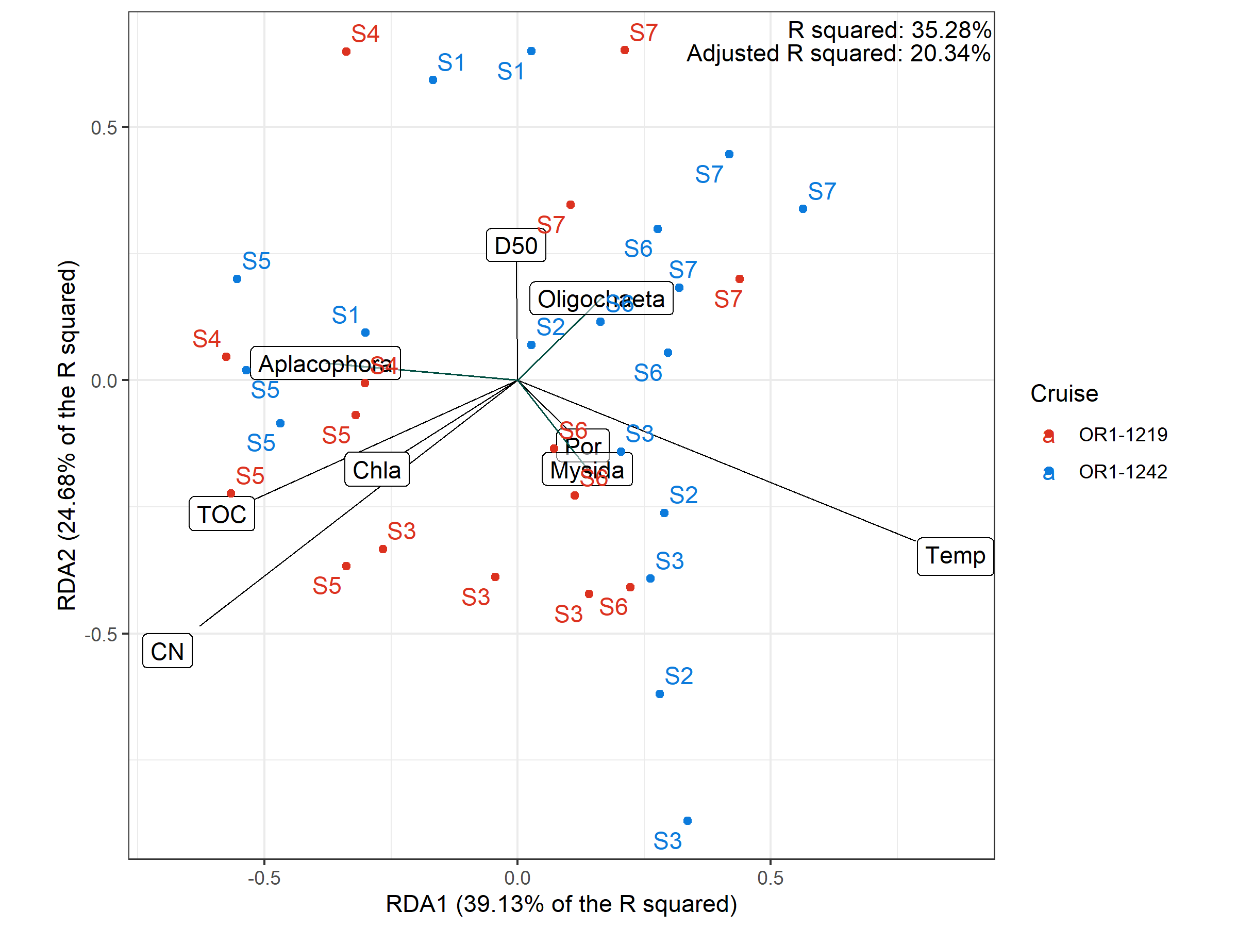
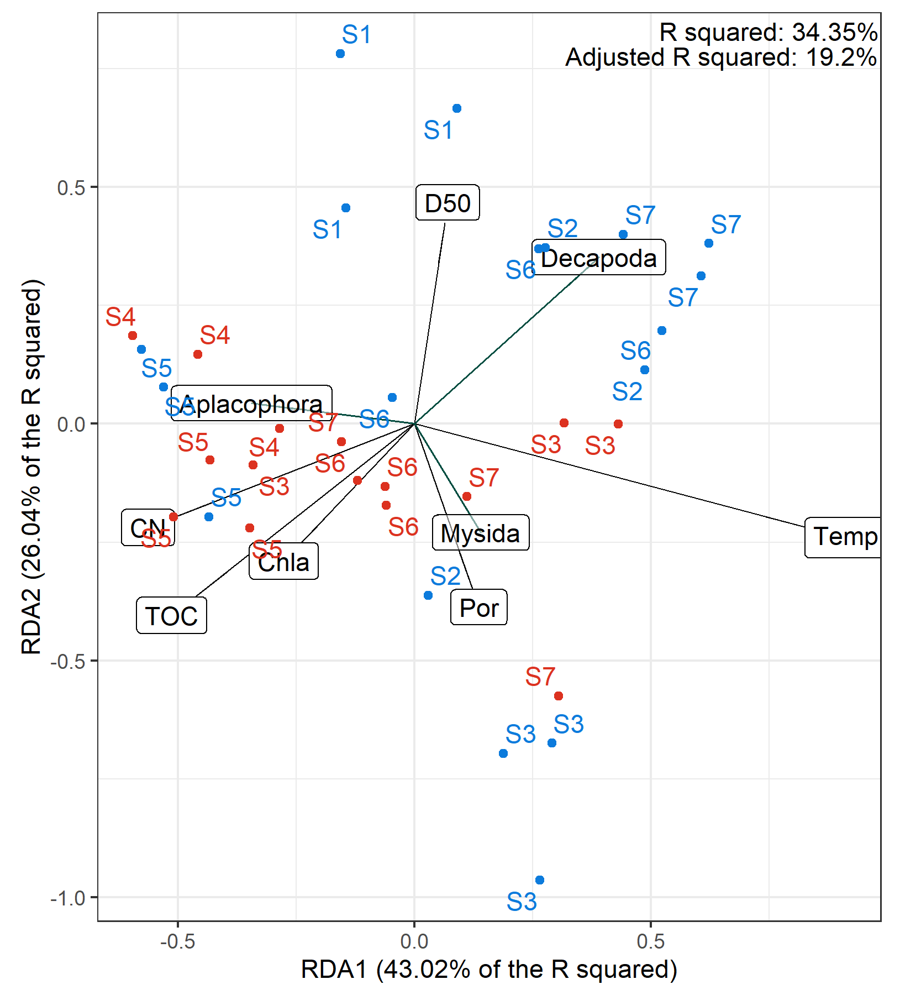
RDA triplot, scaling 1
Biomass, exponent = 0.1
Count, exponent = 0.3
Notes:
Despite PCA based on abundancne and biomass assemblage showed varying results, RDA showed similar ordination patterns.
RDA1 were highly loaded with Temp, TOC, Chla, and CN
RDA2 was loaded with D50 and Por.
The variation of the a bundance and biomass of aplacophorans and mysids were shown.

Slide 5
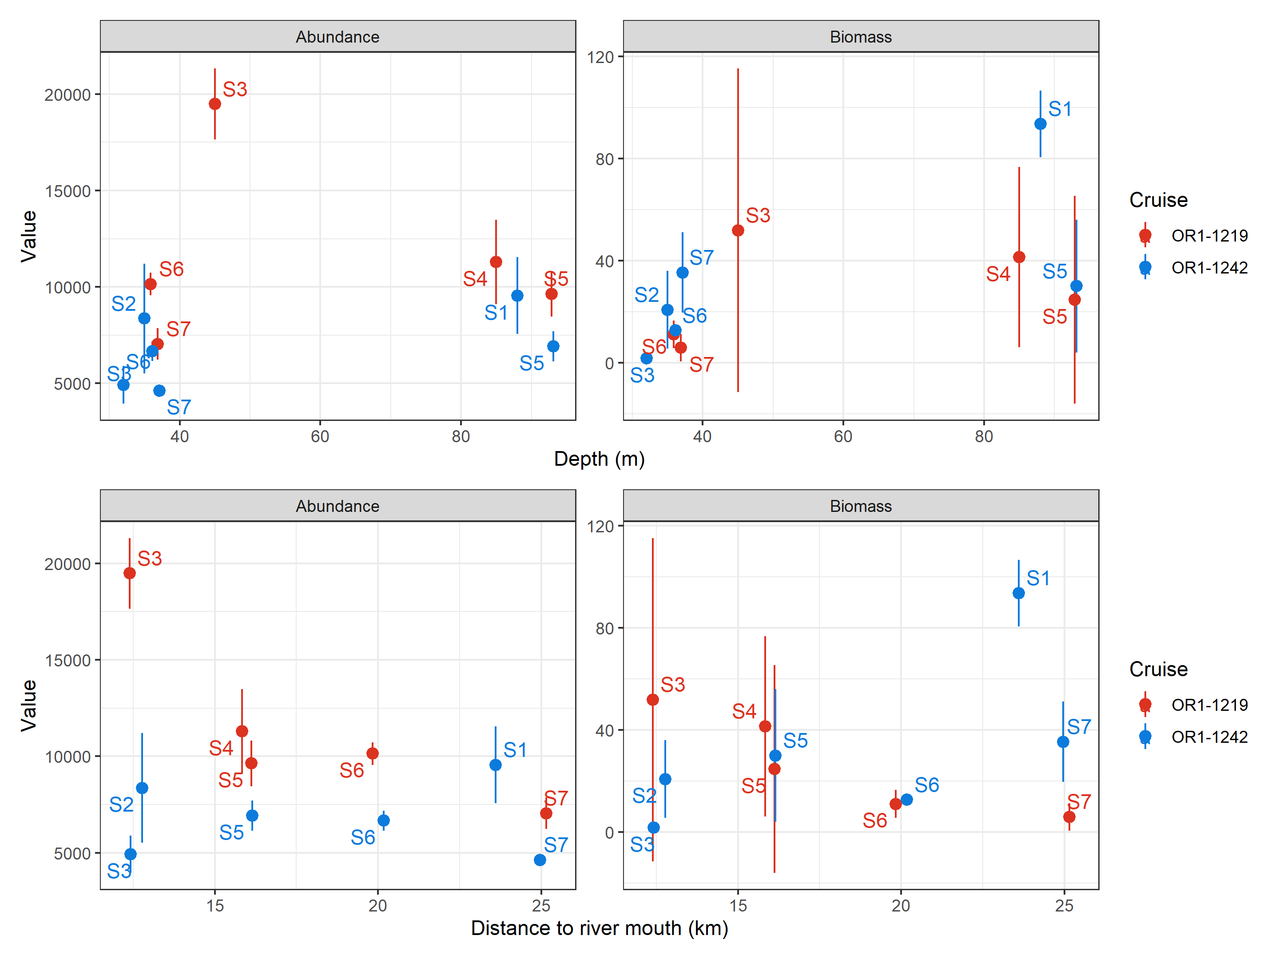
Abundance and biomass variation showed spatiotemporal variations
Add model_avg results here

Slide 6
Add a taxa-size figure (any statistical analyses can be used?)

Slide 7
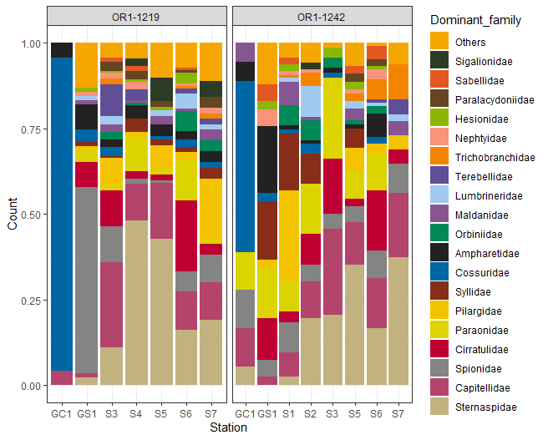
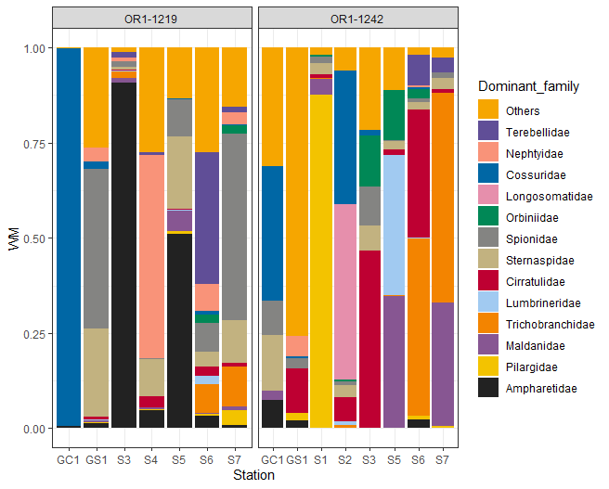
Notes:
Only include complete and head intact specimen since the ecological question is about how many recognizable individuals.
If keeping all the specimen disregarding their condition, the ecological question will essentially become how many specimens can be attributed to certain taxonomic groups.

Slide 8
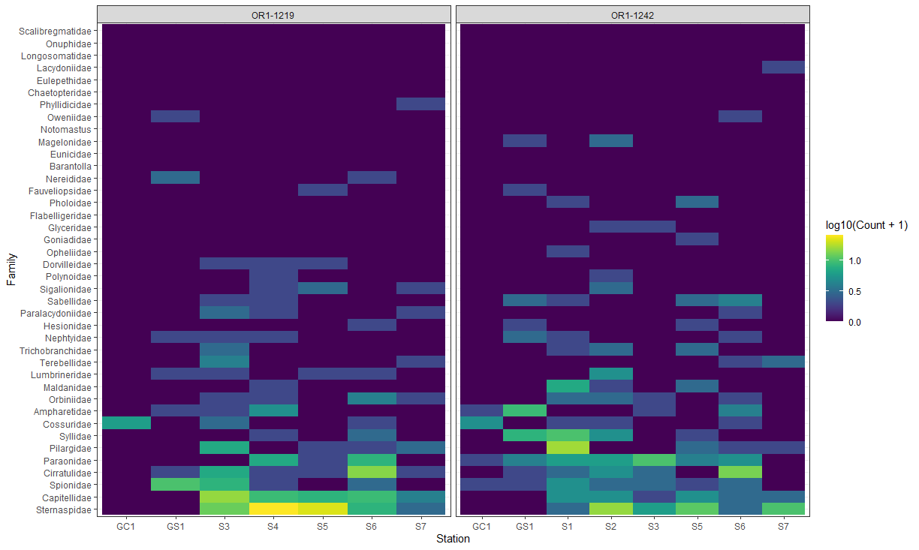

Slide 9
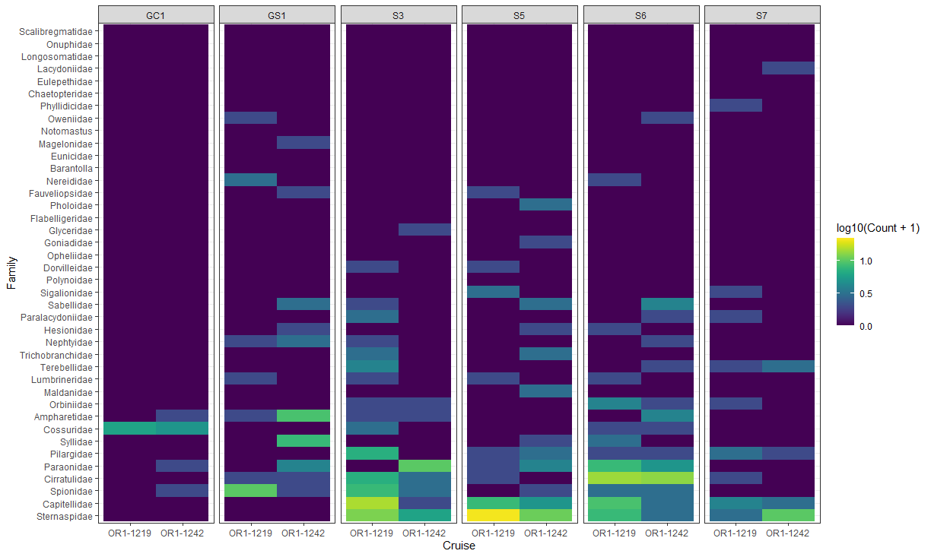

Slide 10
General conclusion
Soft sediments in the GRS is spatiotemporally complex
Space plays a huge role on temporal change (deeper communities were not affected by riverine sediment discharge)

